Slide 1


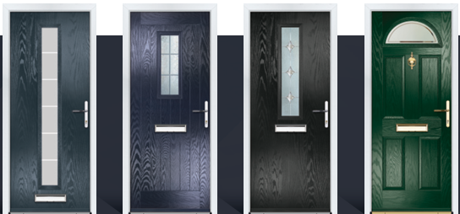
Browse our Door designer with a huge variety of styles and colours available

Slide 2
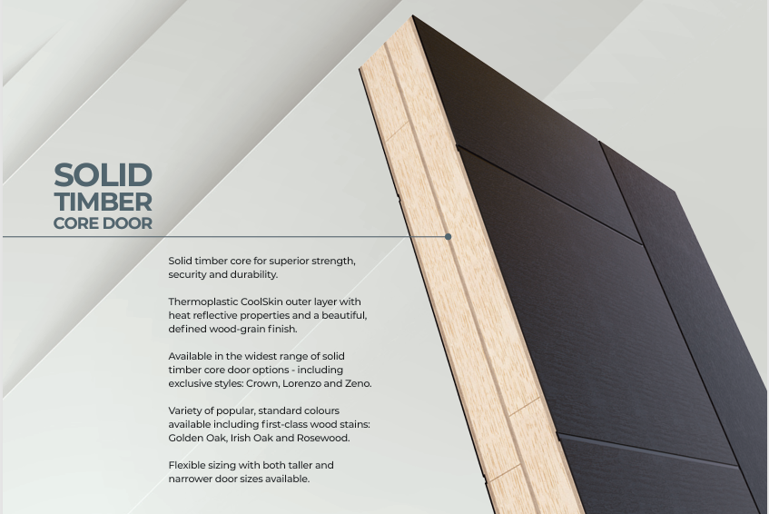


Slide 3
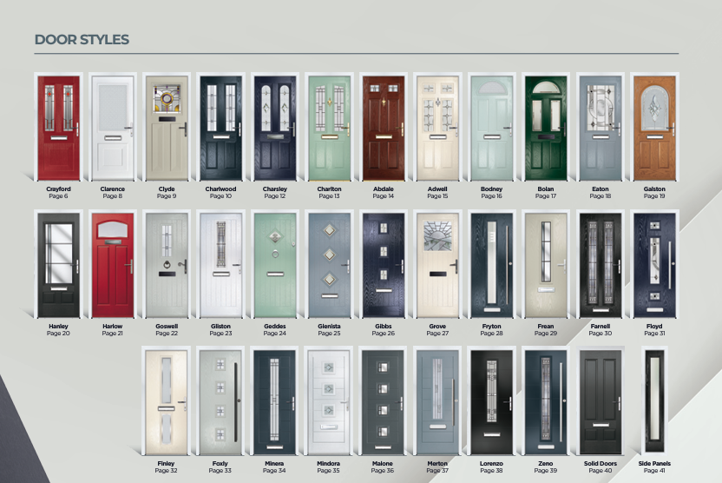
Notes:
If this image is clicked it should go to the door designer

